Slide 1
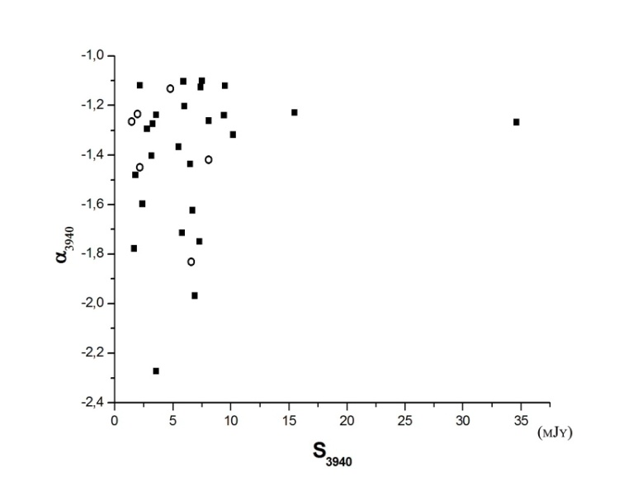
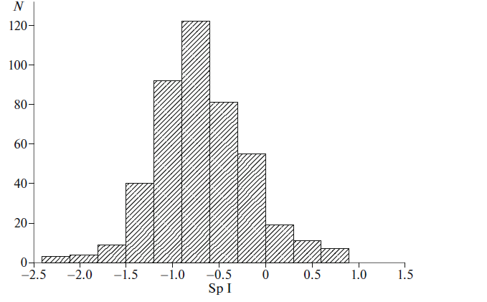
Objects with USS (ultra steep spectra), which are the main indicator for finding possible candidates for distant galaxies, obtained as a result of a deep survey of the sky in the range 0^{h} ≤ RA ≤ 24^{h}, 40.5° ≤ DEC ≤ 42.5° on a radio telescope RATAN-600 at a wavelength 7.6 cm. In the central section of the scan ± 2 ′ out of 448 detected objects, 69 sources turned out to be ultra steep spectra(α< -1.1. S ≈ ν^{α} ) with relatively low-densities S _{3940MHz, median} = 5.8 mJy and S_{1400MHz, median} = 20.8 mJy
Objects with ultra steep spectra in the central section of RATAN Zenith Field(RZF) survey
Yu.N.Pariiskii¹, A.V. Temirova¹, T.A.Semenova ² and N.N.Bursov²
(1) St.Petersburg Branch of SAO RAS, St. Petersburg, Russia
(2) SAO RAS, Nizhnii Arkhyz, Russia
adelina_temirova@mail.ru
N=448
N=27
(b)
For 27 objects with USS spectra for which stellar values in different filters are known (SDSS), photometric redshifts and their radio luminosity at frequencies of 1400 and 3940 MHz are determined
Distribution spectral indices for 448 objects in the RZF survey
Dependence of spectral indices at 3940MHz on the flux density for 27 objects
Notes:
RZF survey

Slide 2
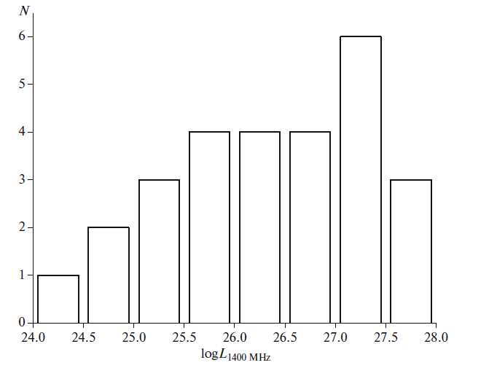
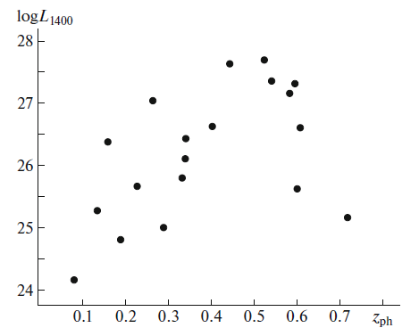
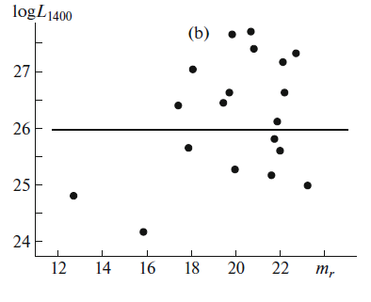
(Miley and De Breuck)
According to the SDSS (DR12) digital optical
survey, using the radio maps of the NVSS and FIRST catalogs, optical identification of objects was
carried out. Our sample of 19 galaxies and
8 star-like objects mainly belongs to the category
of nearby galaxies (N = 12) with
Z ph, gal, mean = 0.27 ± 0.01, found in λ= 7.6 cm.
These radio sources are either located in the dense
intergalactic media of rich clusters of galaxies or are confined within their host galaxies
Distribution of the logarithm of radio luminosities of 27 USS objects at 1400 MHz, log(1400 MHz, median=27.06W/Hz)
Dependence of log L(1400MHz), (L in W/Hz) on redshift Zph
Dependence of log L(1400),(L in W/Hz) on m(r)
for 19 galaxies

Slide 3
The radio luminosity vary in the range 1.51x10²⁴ ≤ L1400 ≤ 5.17x10²⁷ W/Hz , L1400MHz,median~ 4.25 x 10²⁶W/Hz
10 galaxies with radio luminosities L_{1400 МГц} ≥ 10²⁶W/Hz can be attributed to FR II type , of which 4 sources with z_{ph, gal} > 0.5 can be considered as possible candidates for radio-loud active nuclei galaxies (AGNs). The only one galaxy with radio luminosity L_{1400 МГц} = 1.51x10²⁴W/Hz is the rare type FR I. The remaining 8 objects of intermediate luminosities are objects of mixed type FR I− FR II.
Nine of sources have Megahertz Peaked Spectra (MGP), suggesting which that may be High-Z Radio Galaxies ( HZRG).
Objects with unresolved radio morphologies could include Compact Steep Spectrum and GPS (Gigahertz Peaked Spectrum) objects, which may be galaxies located in an early of their evolution toward becoming larges-scale radio sources. Found 2 GPS) objects .
Since most of the radio sources remain unresolved in NVSS and FIRST images observations with higher resolution are required.
Pariiskii et.al. Astronomy Reports, 2019, v.63, №3

